Slide 1
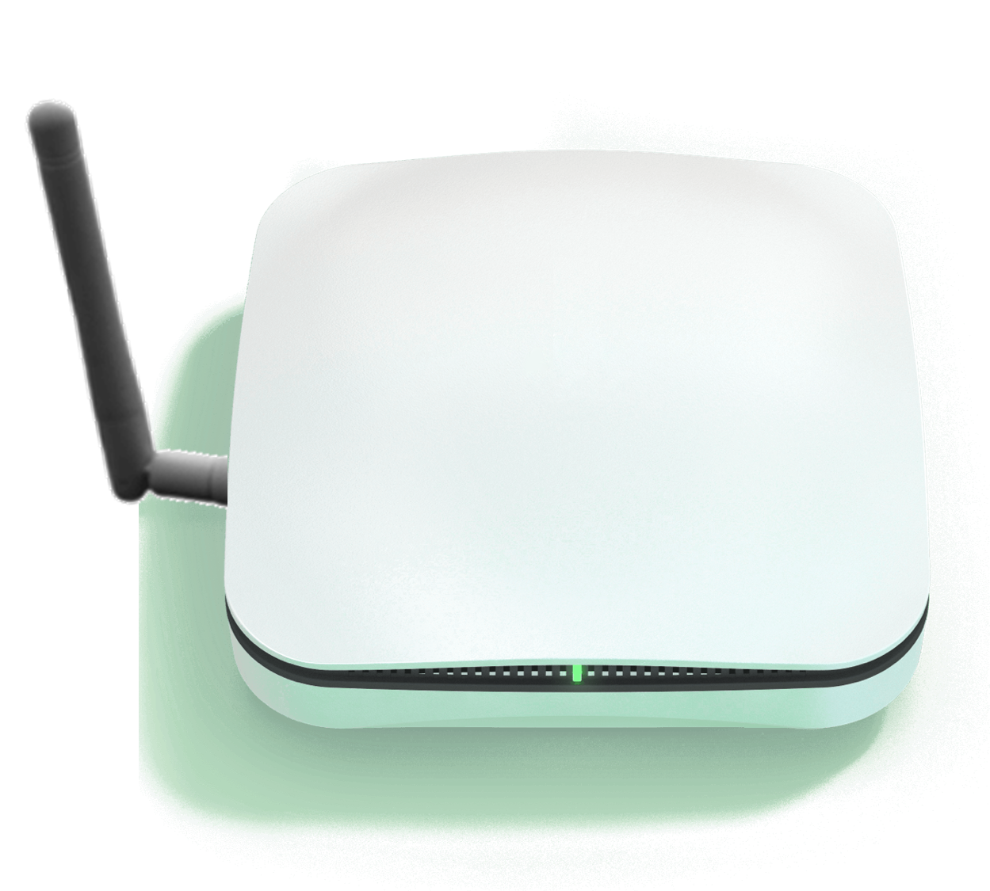

Home Central
Home Central

Slide 2

Door Sensor
CA-SS01

Slide 3
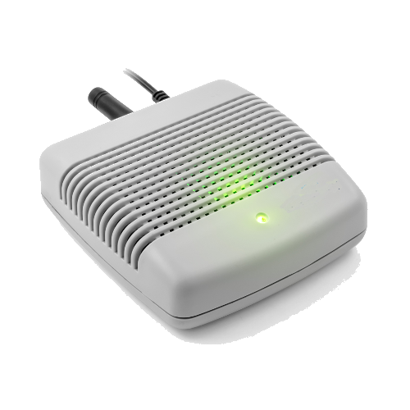
CA-SS03 – AQI Sensor

Slide 4
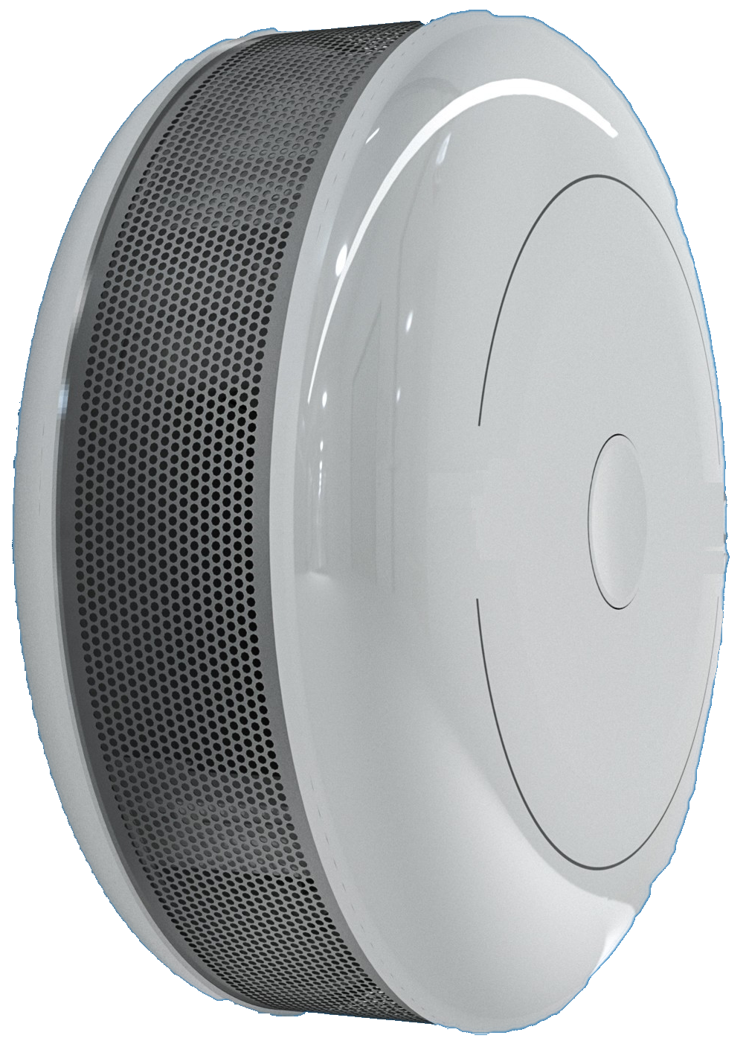
Flame alert
Ga
se
CA-SS04

Slide 5
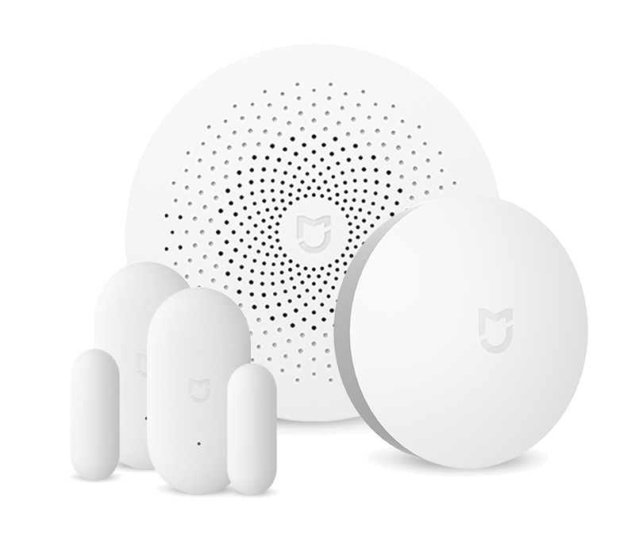

Slide 6
